Slide 1
AirBnb findings
Section 2
Date of presentation: May 2ND 2024
Jacky Chan, Jonathan Farah, Krittika Garg, Ali Nasrallah

Slide 2
Team
Jacky Chan
Jonathan Farah
Krisha Garg
Ali Nasrallah
Notes:
What is the project happening
What does the audience need to know

Slide 3

Project Objective
Conduct a comprehensive analysis of the NYC Airbnb dataset and derive actionable insights for hosts and potential renters
Select relevant features for the predictive model, considering host characteristics, listing details, and geographical factors.
Formulate the problem statement as predicting rental prices based on the chosen features.
Experiment with different machine learning models, considering regression or classification approaches.
Figure 1: AirBnb Investihation
Notes:
Livable dorm rooms for a 100 students

Slide 4
Timeline
Project intro & Dataset Exploration
Feature Exploration
EDA & Visualization
Implementation of machine learning

Slide 5
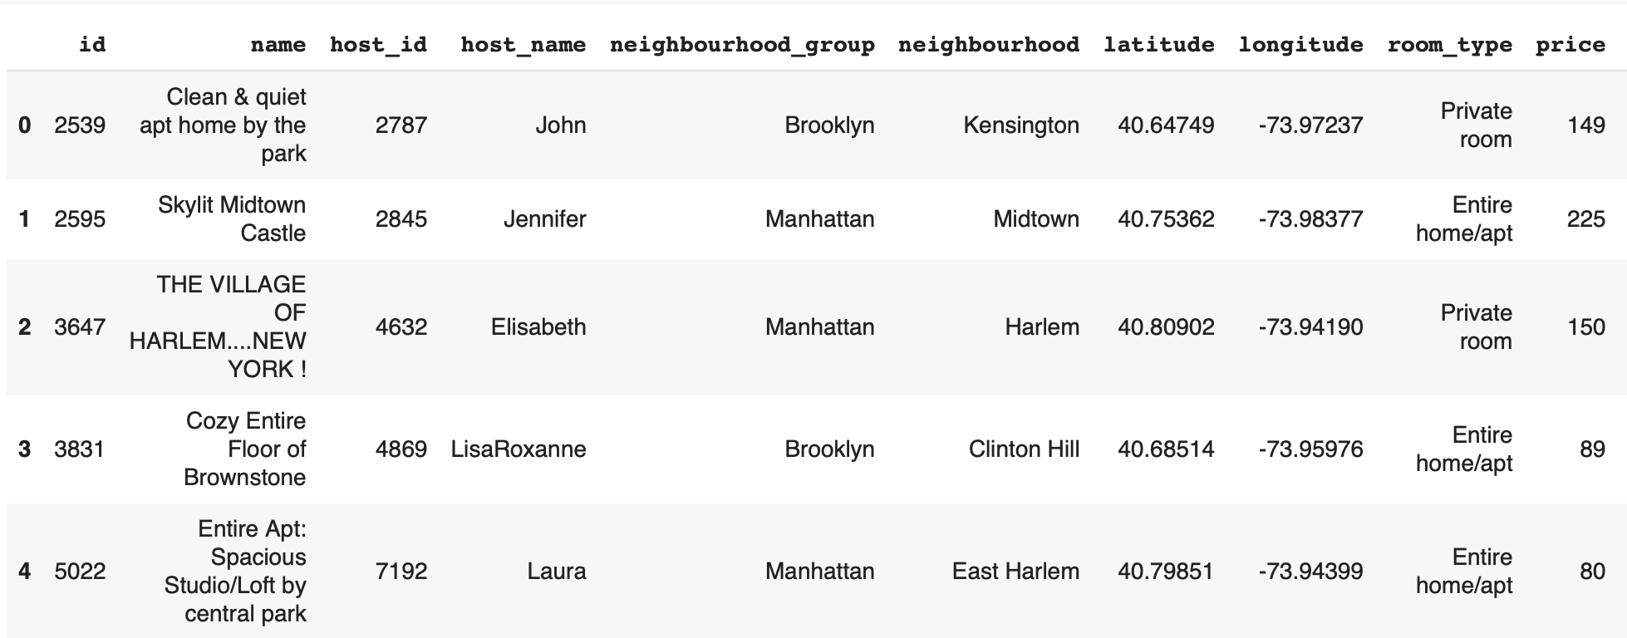
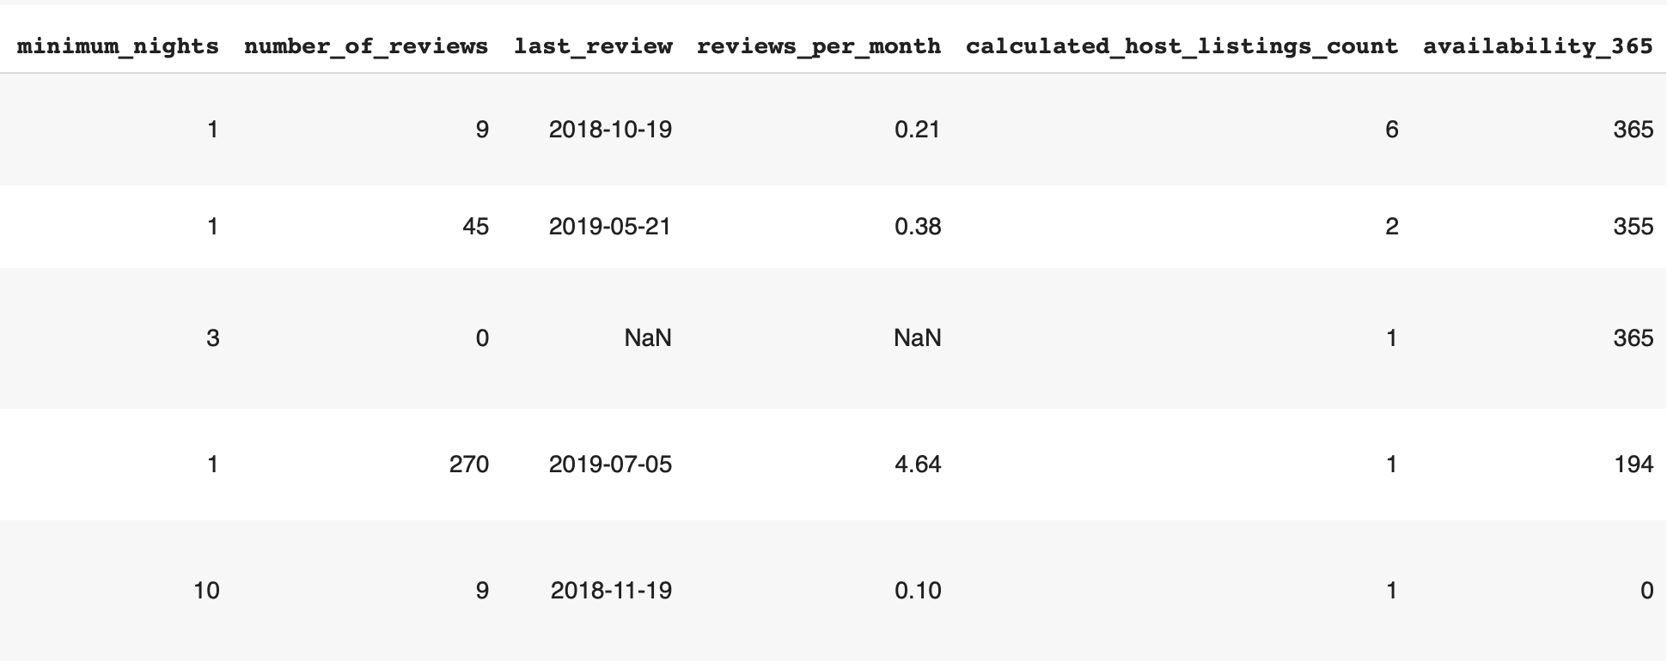
Dataset Exploration NYC Airbnb Data
Read dataset and displayed
df.head()
Notes:
Explaination of design changes if any
Brief explanation of the LEED implementations in Revit
Give a few examples on how it will be accomplished
Revit drawings and renders
Revit floor plan drawing

Slide 6
Exploratory Data Analysis & Visualization
Relevant Features
neighbourhood_group
neighbourhood
latitude
longitude
room_type
number_of_reviews or reviews_per_month or last_review
calculated_host_listings_count
availability_365
minimum_nights
price

Slide 7
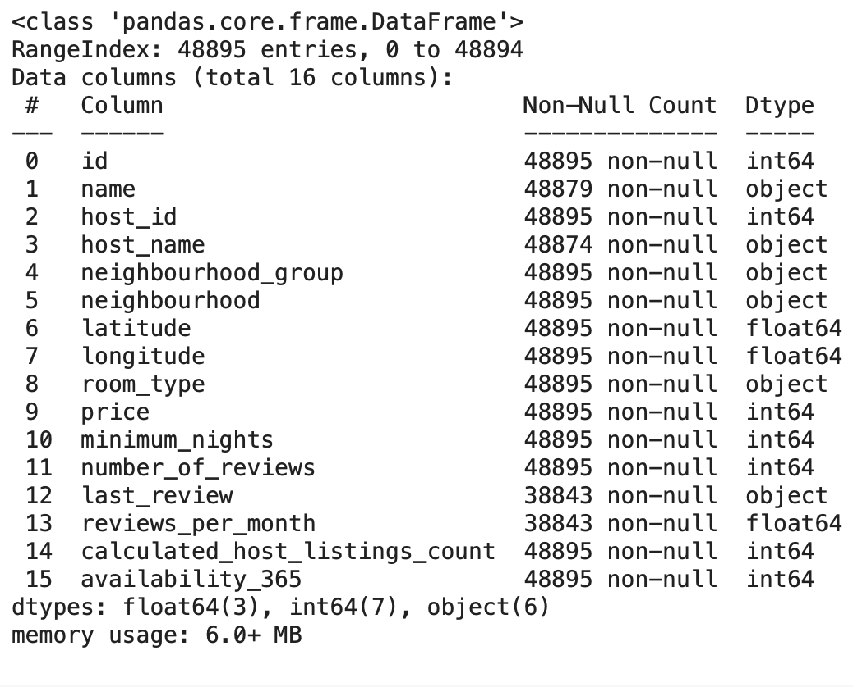
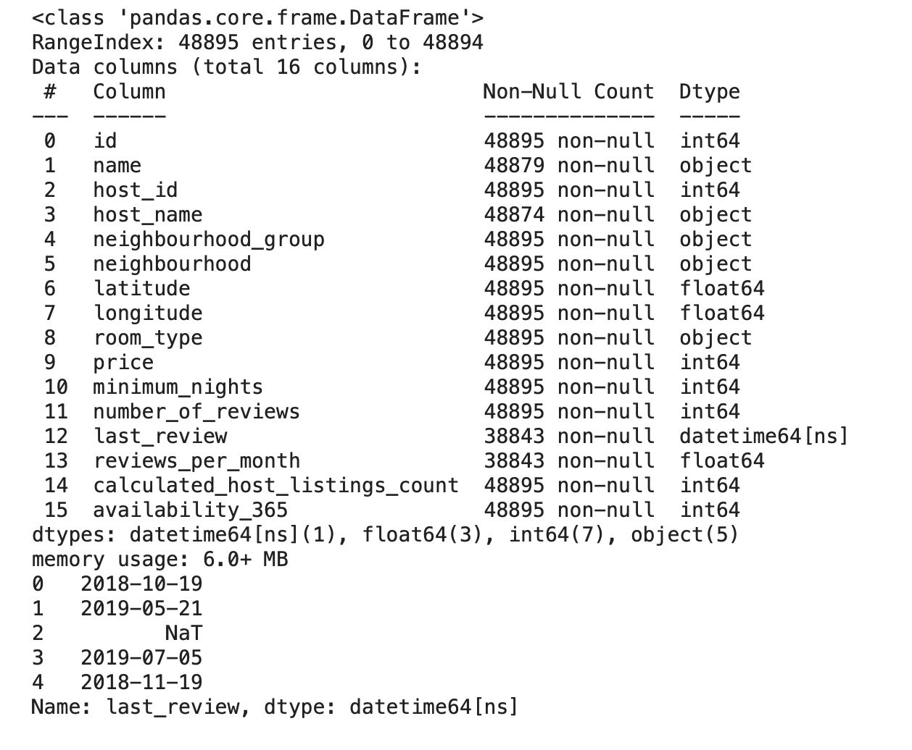
Feature Exploration
Inspected amount of data, data types, and null data.
Set data type of last review to "datetime64"
Ensured that NaN values are explicit

Slide 8
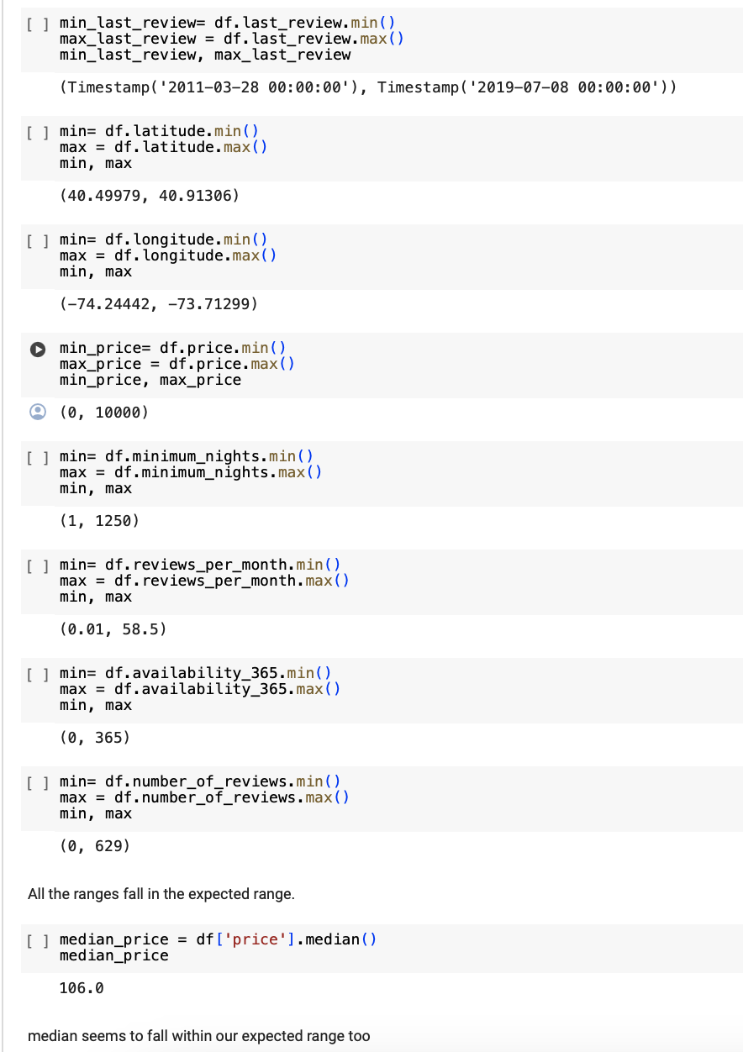
Feature Exploration
For numeric fields, we identified ranges and median values to check if they lie within our expectations.

Slide 9
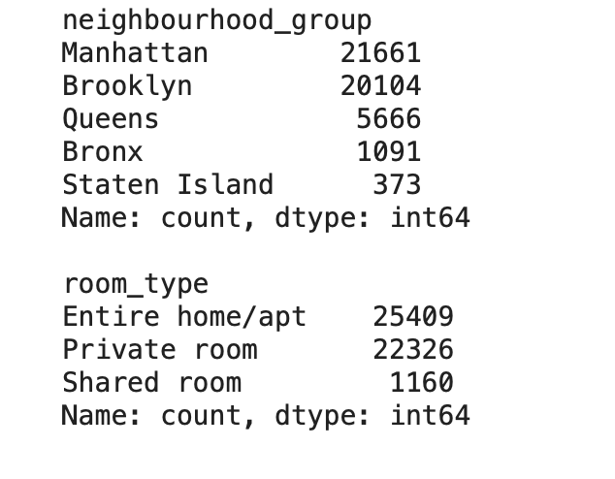
Feature Exploration
For non-numeric values, checked the number of distinct values.
Assessed relationships between variables to check if they aligned with our expectations.
This involved both visual and non-visual (tabular) data analysis.

Slide 10
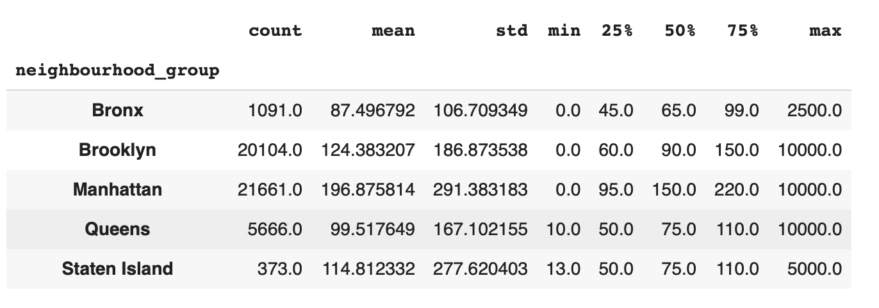
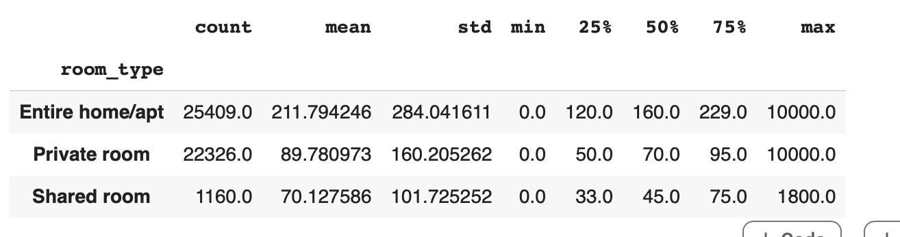
Exploratory Data Analysis & Visualization
Grouped price data by borough and room type
Prices in Manhattan and Brooklyn seem to be higher than other boroughs
Room type seems to have notable influence on price

Slide 11
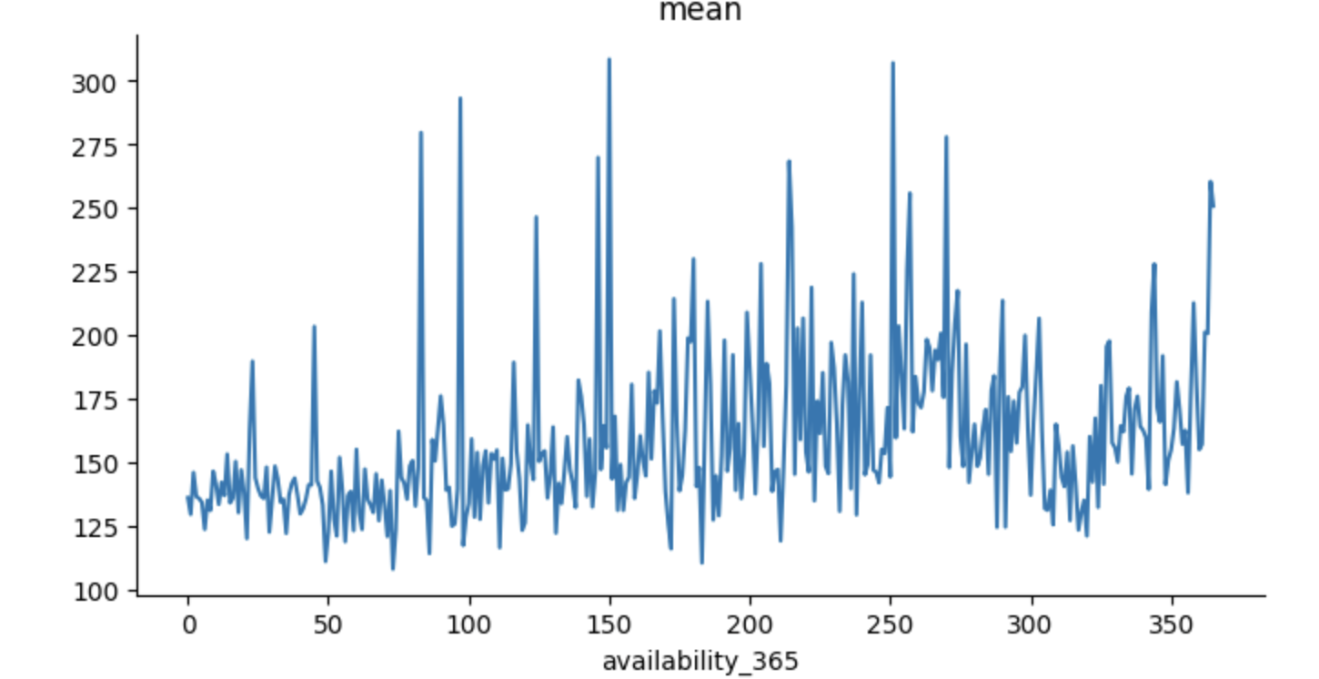
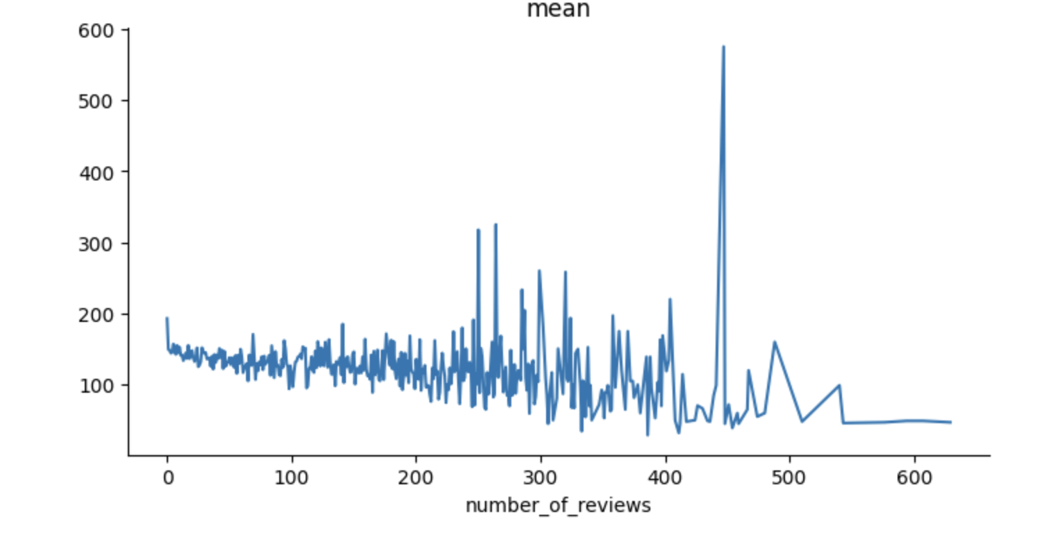
Exploratory Data Analysis & Visualization
The mean price of the AirBnbs seems to increase as their availability increases (overall trend, though with variations). This suggests that AirBnb Rent and Availability could have a relationship
Although the correlation matrix suggests that there is little connection between the numerical features and price, It seems that overall, as the number
of reviews increase, the price decreases.
The trend seems to be clearer if we look
more closely to the start of the graph,since
the value counts for number of reviews
decreases rapidly to be mostly single digit
numbers after number of reviews roughly = 150

Slide 12
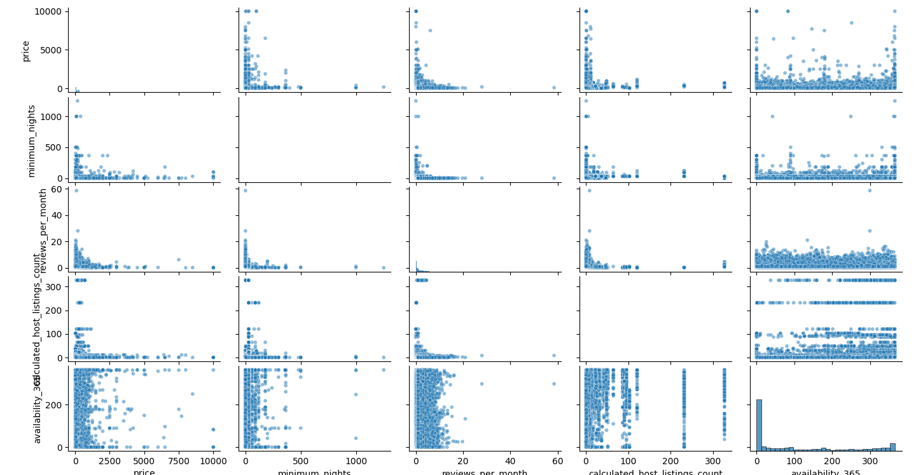
Feature Relationships

Slide 13
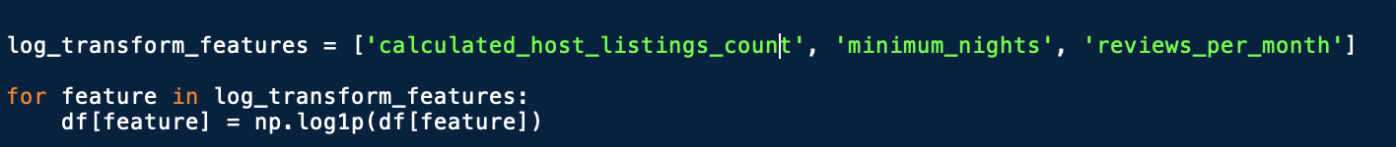
Log Transformation
Log transformation can help normalize the distribution, making it more suitable for linear regression

Slide 14
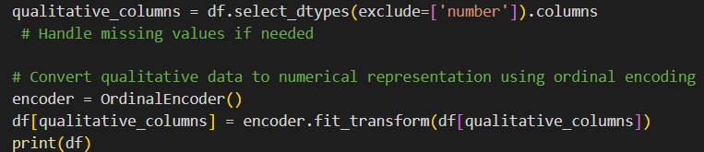
Encoding Categorical Data

Slide 15
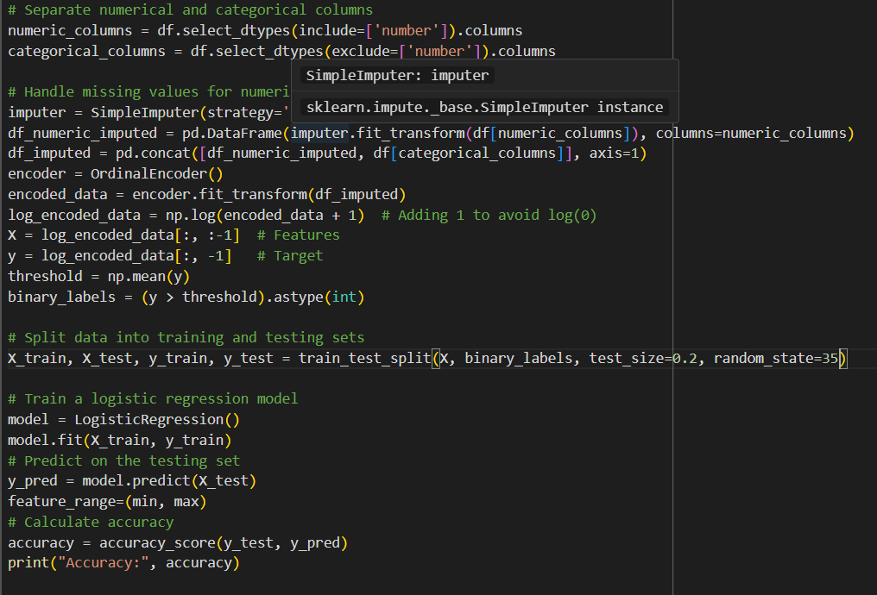
Machine Learning
Used ordinal encoder to turn categorical data to numerical
Used a Logistic Model
Logistic Model provides linear model, while dealing with only discreet output
Handles classification
77% percent accurate

Slide 16
Questions
How to move forward with this project?
How can we manipulate numerical data to extract meaning while still maintaining the validity of the data?
How could we have made the model more accurate?

Slide 17
AirBnb findings
Section 2
Date of presentation: May 2ND 2024
Jacky Chan, Jonathan Farah, Krittika Garg, Ali Nasrallah

